Slide 1
Adaptation of the Flu-FIT Program for Patient Aligned Care Teams
Sofia Funes, DO
Claudia Flores, MS3, Amy Davidow, PhD
Stephen Friedman, MD, Pearl Korenblit, MD, Pauline Thomas, MD
Notes:
Title Slide (1 slide)
• Title of your research/project
• Your Name
• Faculty Adviser with proper credentials
• Site Preceptor with proper credentials
• Site Location

Slide 2
INTRODUCTION
Colorectal cancer (CRC) deaths can be prevented with appropriate screening.
Flu-FIT: a research-tested intervention program linking annual influenza immunization and colorectal cancer screening (CRCS) using a
fecal immunochemical test (FIT).
Currently the VA CRCS rate is 77%, they would like it to be higher, over the national VA rate of 82%.
This is a second implementation of Flu-FIT as a quality improvement project for patient aligned care teams (PACT) at the US Department of Veterans Affairs (VA).
Objective:
Implement the Flu-FIT project at the East Orange VA, to increase annual CRCS rates above 82% in participating primary care Flu-FIT teams during the 2019-2020 influenza season
Notes:
Introduction/Background (1 slide)
• Literature Review: what the literature says regarding your topic
• Your view on this project: the hole in the literature that you are trying to fill
• Purpose of the study: what you are testing in this project

Slide 3
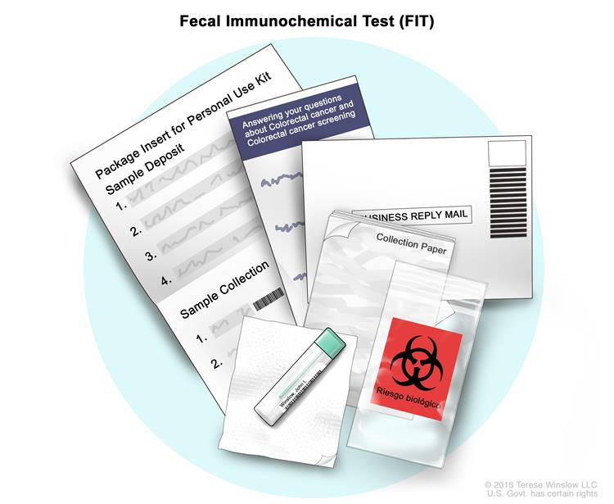
METHODS
Six participating primary care clinics participated in the Flu-FIT project.
Six other clinics were only monitored and CRCS rates compared.
Training session for participating nurses: detailed scripts for offering CRCS and educating patients on CRCS options.
Patient charts pre-screened monthly; list of eligible patients provided to nurses.
Eligility Criteria
Age: 50 - 75 y.o.
No colonoscopy <10 yrs prior
No FIT < 1 yr prior
No recent rectal bleeding
No Family History of CRC before age 60
Patient data and FIT completion: October 1, 2019 to April 15, 2020.
VA protocol remained unchanged:
Referral to colonoscopy for positive FIT
Documentation and medical record reminder system.
Notes:
Methods (1 slide)
• Explain how you got your data (Quantitative/Qualitative)
• Subjects
• Sampling design
• How you collected your data
• Analyses Conducted
Image Reference:
https://www.cancer.gov/images/cdr/live/CDR784770-750.jpg

Slide 4
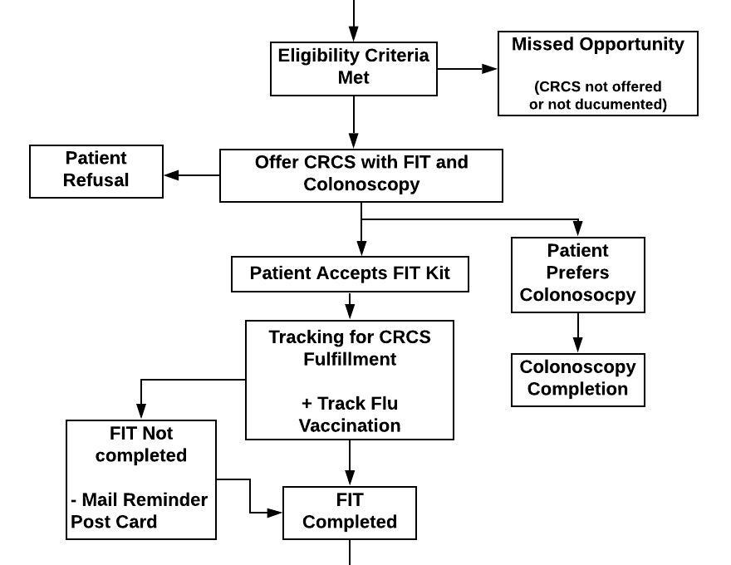
FIGURES
Notes:
Data Tables/Figures (1-3 slides)
• Include all relevant tables and charts
• This can be more than one slide
• For presentation purpose circle or highlight important numbers/concepts that stand out

Slide 5
DATA TABLES
Table 1. Demographics | Standard Care (n=267) | Flu-FIT (n=242)
Age
mean (SD) | 65 (7.26) | 66 (7.21)
Gender
Male, no. (%) | 225 (84.27) | 231 (95.45)
Female, no. (%) | 42 (15.73) | 11 (4.55)
Race/Ethnicity, no. (%)
Black or African American | 140 (52.43) | 139 (57.44)
White | 87 (32.58) | 58 (23.97)
Hispanic | 12 (4.49) | 17 (7.02)
Other | 28 (10.49) | 28 (11.57)
Notes:
Data Tables/Figures (1-3 slides)
• Include all relevant tables and charts
• This can be more than one slide

Slide 6
RESULTS
Table 2. Outcomes | Standard Care (n=267) | Flu-FIT (n=242) | OR (95% CI) | p
Eligible for FIT | 193 (72.3) | 175 (72.3) | 1.00 (0.68, 1.48) | 0.99
Accepted FIT | 51 (19.1) | 88 (36.4) | 2.42 (1.62, 3.62) | <0.001
Completed FIT | 26 (9.7) | 36 (14.9) | 1.62 (0.95, 2.77) | 0.07
Prefers Colonoscopy | 50 (18.7) | 48 (19.8) | 1.07 (0.69, 1.67) | 0.75
Completed Colonoscopy | 6 (2.3) | 15 (6.2) | 2.87 (1.09, 7.53) | 0.02
Received Flu Vaccine | 163 (61.1) | 135 (55.8) | 0.81 (0.57, 1.15) | 0.22
CRCS Up-to-date | 32 (12) | 51 (21.1) | 1.96 (1.21, 3.17) | 0.006
Notes:
Results (1 slide)
• Explain main findings
• Don’t repeat the results from the tables word for word
• For presentation purpose circle or highlight important numbers/concepts that stand out

Slide 7
DISCUSSION
Statistically significant increase in FIT acceptance and colonoscopy completion in clinics using Flu-Fit program
Overall increase in CRCS rates with use of both FIT and colonoscopy
from a 77% pre-intervention rate to:
81.9% in Flu-FIT group
79.8% for standard care group
Limitations:
Lack of randomization of the Flu-FIT and standard care patient groups
Results not generalizable as project took place in an integrated healthcare system with unique patient population (Veterans)
Implications for future projects
Only 36 out of 88 patients accepting a FIT kit in study group completed the testing
Project reach limited to the patients visiting the clinic during the influenza season, but protocols may be adapted to run year-round in future implementations
Notes:
Discussion (1 slide)
• Emphasize main findings
• Put findings into context based off what is already known
• Draw new conclusions
• List the strength/weaknesses of your study
• Discuss the implications of your research for future studies, clinical application, education or policy

Slide 8
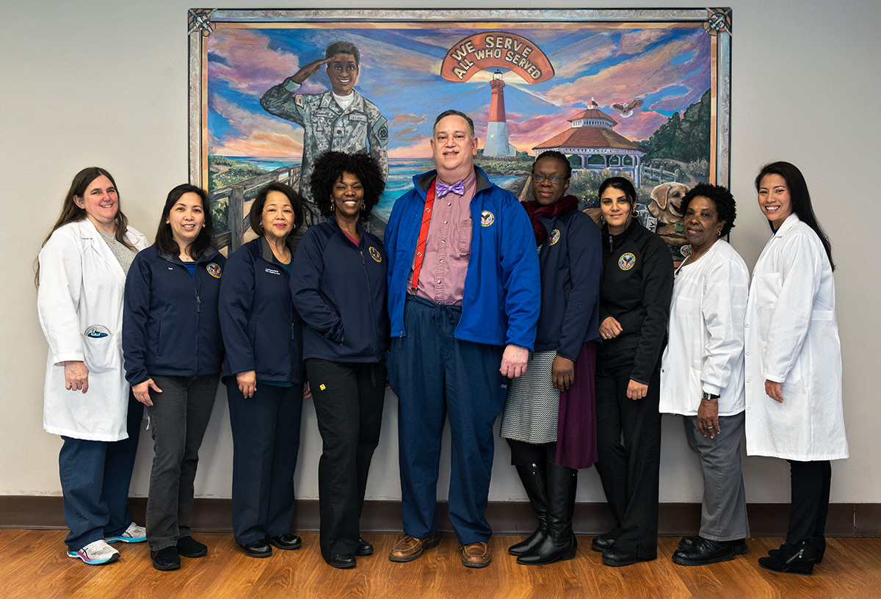
ACKNOWLEDGEMENTS
Support for this project was provided to the Preventive Medicine Residency Program
by the American Cancer Society Physician Training Award in Cancer Prevention
and the East Orange VA Hospital.
Special Thanks
The Preventive Medicine Faculty: Dr. Thomas, Dr. Davidow, Dr. Friedman and Dr. Korenblit
Medical Student Research Assistant: Claudia Flores
The PACT nursing team that made this project possible:
Nurse Vera, Resvelyn, Mary, Janice, Kim, Margarette, Mable, and Rudolfo
Notes:
Acknowledgements (1 slide)
• Acknowledge those that helped you
• If grant funded acknowledge them as well

Slide 9
REFERENCES
U.S. Cancer Statistics Working Group. U.S. Cancer Statistics Data Visualizations Tool, based on November 2017 submission data (1999-2015): U.S. Department of Health and Human Services, Centers for Disease Control and Prevention and National Cancer Institute; www.cdc.gov/cancer/dataviz, June 2018.
Fight Colorectal Cancer. Fight Colorectal Cancer - Facts and Stats. 2018. October 2018 <https://fightcolorectalcancer.org/prevent/about-colorectal-cancer/facts-stats/>.
US Preventive Services Task Force. Screening for Colorectal Cancer. US Preventive Services Task Force Recommendation Statement. JAMA. 2016;315(23):2564–2575. doi:10.1001/jama.2016.5989
Potter, Michael B, et al. “Effectiveness and Reach of the FLU-FIT Project in an Integrated Health Care System: a Multisite Randomized Trial.” American Journal of Public Health, vol. 103, no. 6, June 2013, pp. 1128–33, doi:10.2105/AJPH.2012.300998.
Potter, Michael B., et al. “The Effectiveness of the FLU–FOBT Project in Primary Care: A Randomized Trial.” American Journal of Preventive Medicine, vol. 41, no. 1, Elsevier Inc., 2011, pp. 9–16, doi:10.1016/j.amepre.2011.03.011.
Ursin, G, et al. “Colorectal Cancer Screening Pilot: Comparative Effectiveness Research Using Two Screening Modalities.” Cancer Research, vol. 74, no. 19, AMER ASSOC CANCER RESEARCH, Oct. 2014, pp. 3242–3242, doi:10.1158/1538-7445.AM2014-3242.
Notes:
References (As many slides as your citations take up)
• Make sure these references are in APA format

Slide 10
REFERENCES
Potter, Michael B, et al. “The FLU-FIT Project: An Effective Colorectal Cancer Screening Project for High Volume Flu Shot Clinics.” The American Journal of Managed Care, vol. 17, no. 8, 2011, pp. 577–83.
Walsh, Judith M. E., et al. “The FLU-FOBT Project in Community Clinics: Durable Benefits of a Randomized Controlled Trial.” Health Education Research, vol. 27, no. 5, Oxford University Press, Oct. 2012, pp. 886–94, doi:10.1093/her/cys063.
Potter, Michael B, et al. “Adaptation of the FLU-FOBT Project for a Primary Care Clinic Serving a Low-Income Chinese American Community: New Evidence of Effectiveness.” Journal of Health Care for the Poor and Underserved, vol. 22, no. 1, 2011, pp. 284–95, http://muse.jhu.edu/journals/journal_of_health_care_for_the_poor_and_underserved/v022/22.1.potter.html.
Potter, Michael B, et al. “Offering Annual Fecal Occult Blood Tests at Annual Flu Shot Clinics Increases Colorectal Cancer Screening Rates.” Annals of Family Medicine, vol. 7, no. 1, 2009, pp. 17–23, doi:10.1370/afm.934.
Sofia, Funes, et. al. “Adaptation of the Flu-FIT program for a primary care clinic serving military Veterans in East Orange, New Jersey.” American College of Preventive Medicine 2019 Conference, Poster Presentation.

